Slide 1
Analysis of Crime Data
for New York City
Reactions in a Pandemic
Benjamin Grossmann

Slide 2
Ability of
Police Departments to Function
has been Affected by the Pandemic
Headlines
COVID has killed 5 times as many police officers as gunfire during pandemic
(CNN, October 20, 2021)
nationwide trend
* * * * *
Unvaccinated NYPD officers get final ultimatum after exemption requests are denied
(Gothamist, April 23, 2022)
11% of the NYPD workforce not vaccinated

Slide 3
Ability of
Police Departments to Function
has been Affected by the Pandemic
How should
the NYPD
distribute its resources
to increase its
Ability to Respond?

Slide 4
The Data
Data Source: NYC OpenData
Public data published by New York City agencies and partners
https://opendata.cityofnewyork.us/
Data Set: NYPD Complaint Data Current (Year To Date)
Crimes reported to the NYPD
Updated Quarterly
Data retrieved April 8, 2022
Data Information
Crime Descriptions
Locations and Times
Suspect and Victim Demographics

Slide 5
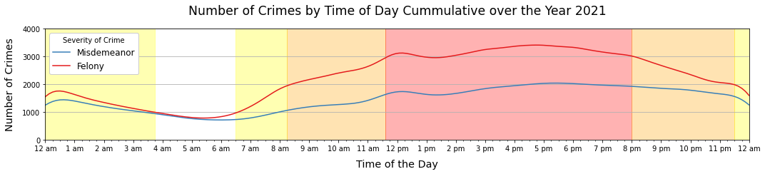
When is Crime More Likely to Happen
Few crimes happen in the morning
Bump in crime around noon
Most crimes happens in the afternoon and early evening
Low crime rates
High crime rates

Slide 6
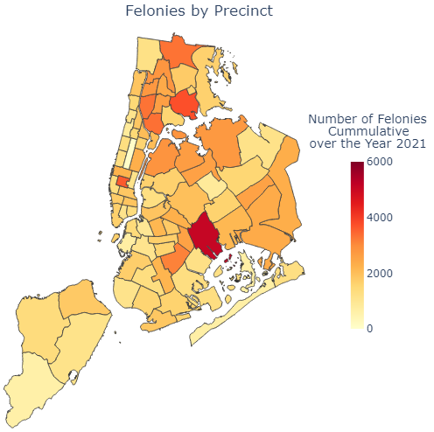
Where is Crime More Likely to Happen
Crime is lowest on Staten Island
Crime increases going east and north
Unusually Low Crime Precincts
22nd Precinct in Manhattan (Central Park)
112th Precinct in Queens
Unusually High Crime Precincts
14th Precinct in Manhattan
75th Precinct in Brooklyn
22
14
112
75

Slide 7
Model for Predicting Crime
Multiple models created to predict crime
Help make decisions on when and where officers are likely to be needed
Physical presence as deterrent
Reduce response time
Best Model
82% Accuracy Predicting Violations
51% Accuracy Predicting Misdemeanors
67% Accuracy Predicting Felonies The most dangerous crimes are only accurately predicted 2/3 of the time.
Model drawbacks
Does not account for holidays
Does not account for how weather may affect outdoor crimes
Does not account for age or sex of suspect

Slide 8
Recommendations
Short term recommendations
Prepare a reassignment roster
Redistribute officers to adjacent precincts
Balance ratio of officers to crime rate across precincts
Prepare a rescheduling plan
Maintain more officers on duty during the afternoon and evening
Long term recommendations
Study why some precincts have unusually high and low crime rates
Joint operation with other city agencies

